Slide 1
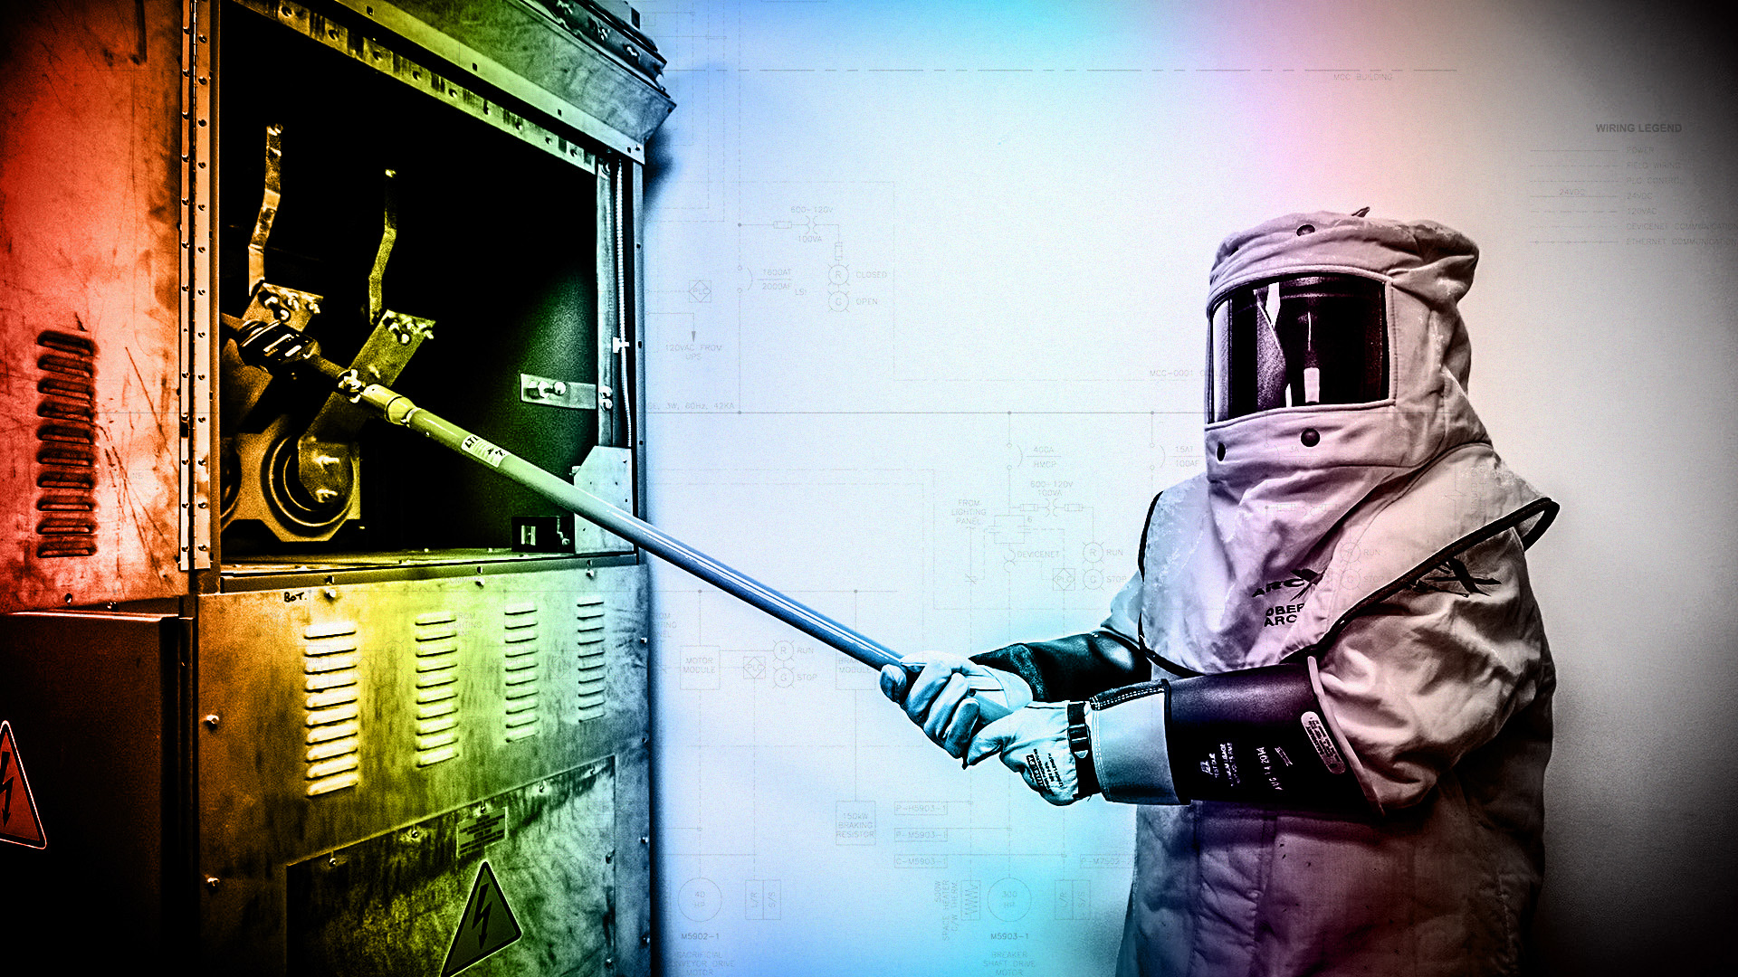



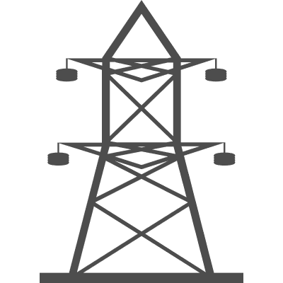

ENGG404 - LECTURE
Fundamentals of RM
RM System and Process
Leadership in RM
Incident Investigation
RM Tools & Challenges
RM in Industry
People & Org.
Application and Perspectives
Safety and Risk Management in the Electrical Engineering Industry

Slide 2

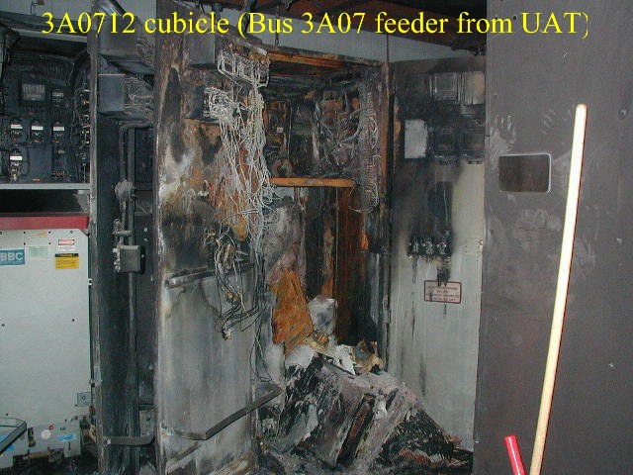
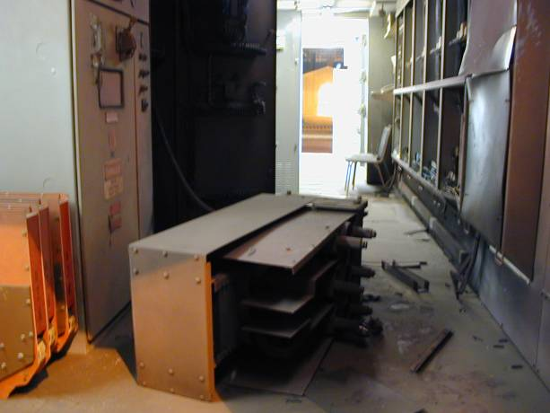
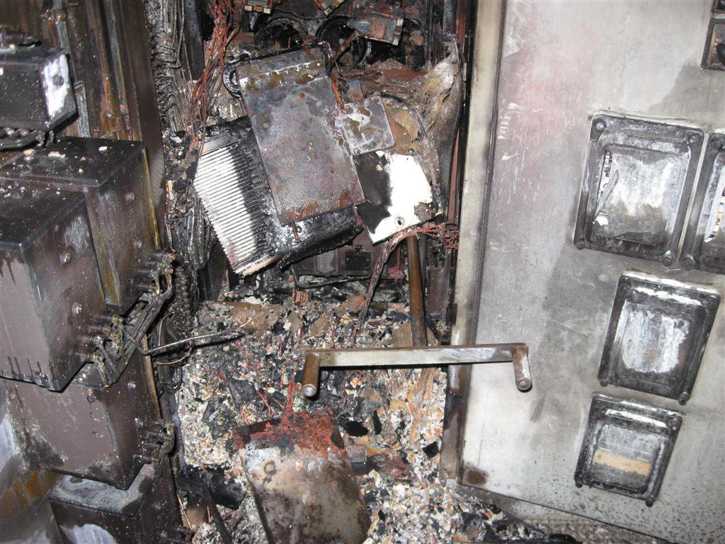
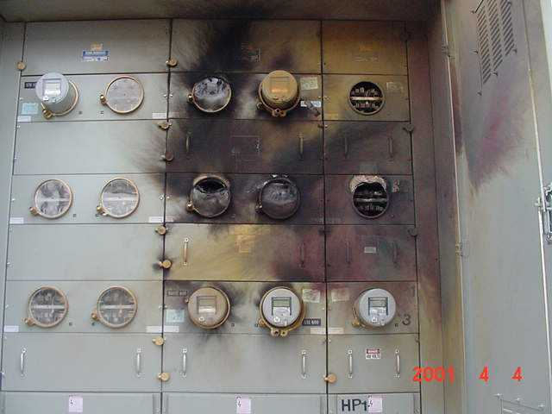

Slide 3

Learning Outcomes
Apply the Risk Management Work Process to Electrical Hazards in Industry
Explain 3 specific Risk Management Elements
Design, Construction and Start-up.
Operations and Maintenance.
Operations and Facilities Information and Documentation.
Recognize the limitations of our understanding
You don’t know what you don’t know

Slide 4
Electric Shock

Slide 5
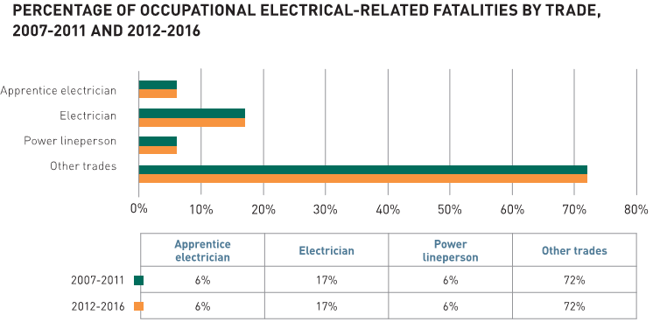
Electrical Facilities
Workplace Fatality Statistics in Alberta
Workplace Fatality Statistics in Ontario
2017: 34 Fatalities (0 Electrical)
2016: 27 Fatalities (0 Electrical)
2015: 25 Fatalities (0 Electrical)
2014: 47 Fatalities (1 Electrical)
2013: 41 Fatalities (0 Electrical)
2012: 42 Fatalities (1 Electrical)
As reported by Alberta Labour, “Workplace Incident Fatalities Accepted by WCB”
In Ontario, from 2007 to 2016 there were 54 deaths from electrocution (death caused by non-intentional contact with electricity or by the effects of electrical burns)

Slide 6
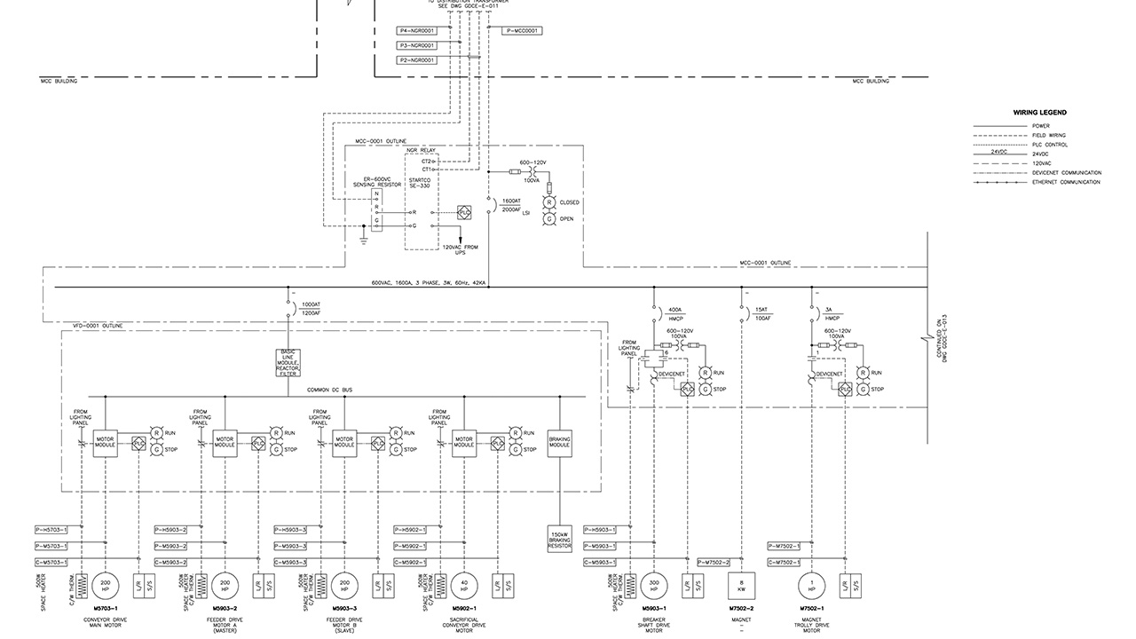
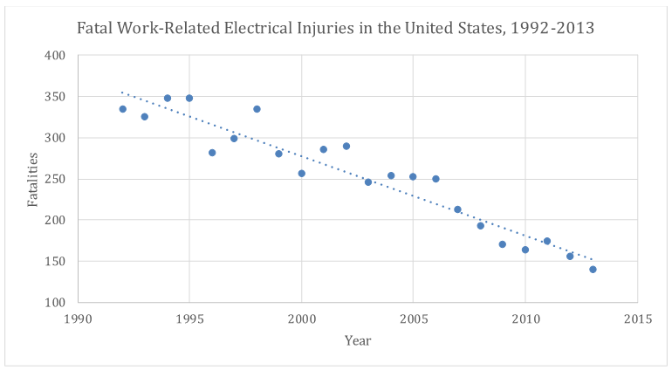
Data from the U.S. Bureau of Labor Statistics (BLS) indicate that there were nearly 6000 fatal electrical injuries to workers in the United States from 1992 through 2012
Approximately 98 % of fatal occupational electrical injuries are electrical shock injuries

Slide 7
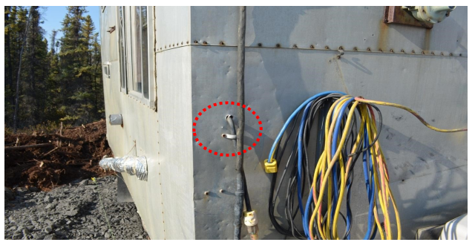
Electrical Shock - Example
2012 Alberta electrical fatality:
A worker was fatally electrocuted while installing plumbing underneath a portable trailer. The exterior cladding of the trailer became electrically energized when a flexible cable was run through a hole without any mechanical protection.
As reported by Alberta Municipal Affairs and Housing
Photo: Alberta OH&S Fatality Investigation Report – Low Voltage Electrocution

Slide 8
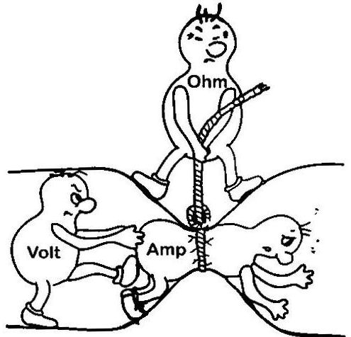
Introduction to Electricity

Slide 9
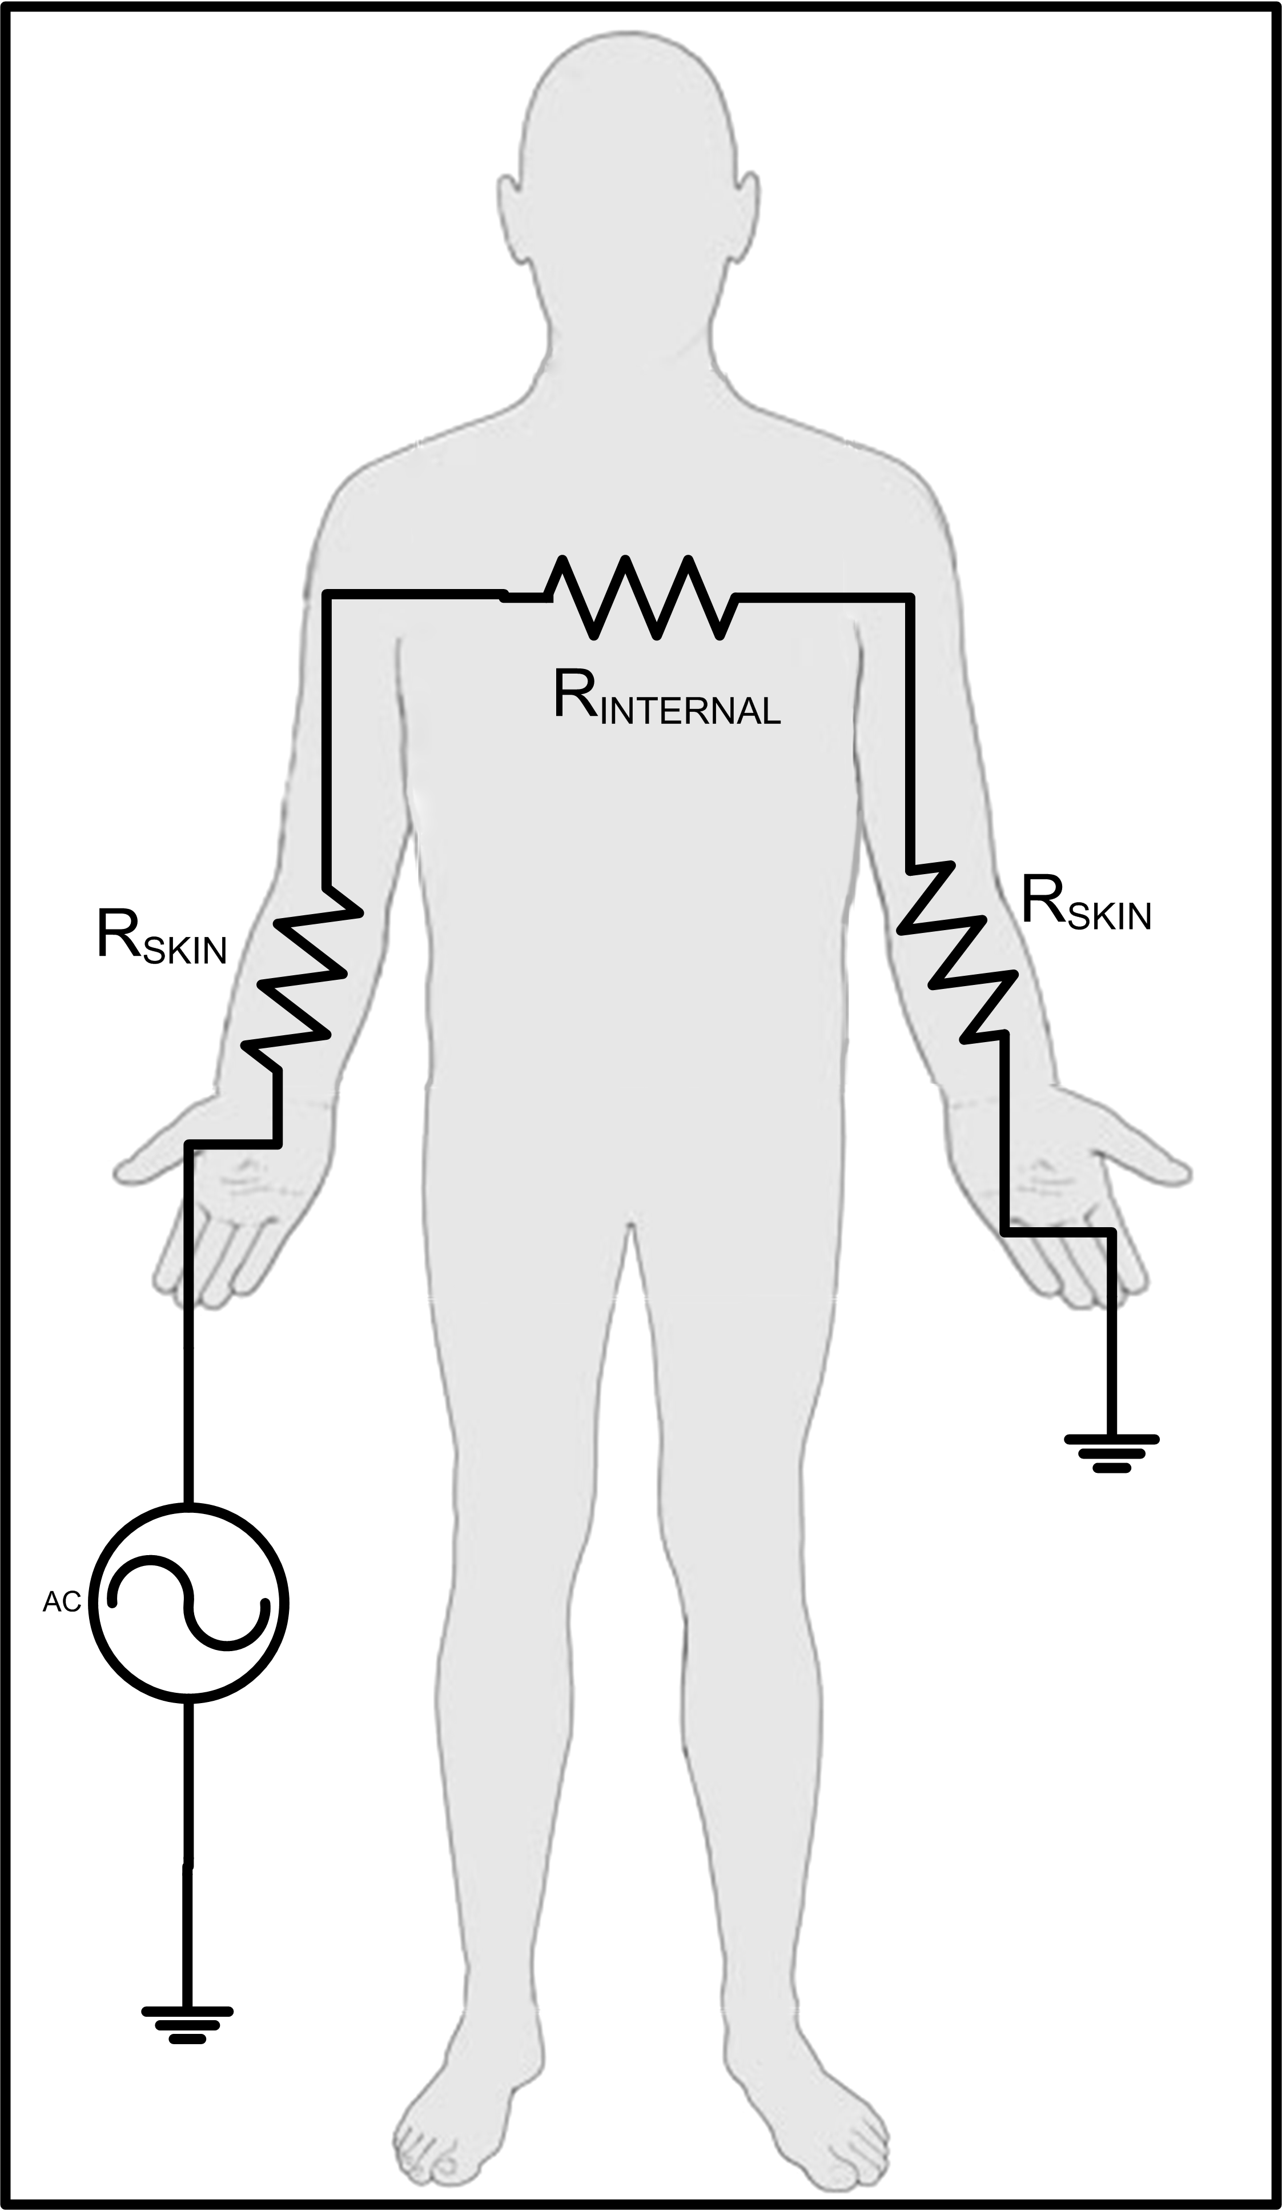
What is electric shock?
An electric shock can occur upon contact of a human’s body with any source of voltage high enough to cause sufficient current through the muscles or hair
A few basic facts:
Human perception of shock is approximately 1mA AC
Heart fibrillation occurs at 50-100mA
Fatal cases of electric shock referred to as electrocution
Ohms Law: I = V/R
Current flow, or shock severity is a function of voltage and resistance
Current must enter and leave the body, source and return. If there is no path, there is no current flow and therefore no shock.

Slide 10
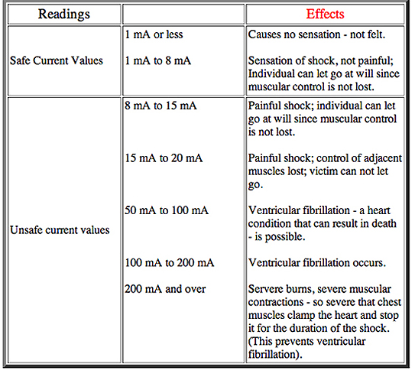
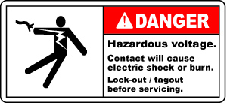

Slide 11
Prevention
Industry Codes, Standards, and Guidelines
Canadian Electrical Code (CEC)
Provincial Safety Codes & Municipal Inspection Authorities
Industry Standards
IEEE – Several thousand
ANSI, NEMA, IEC – Industry Associations
Consumer Protections
CSA, ULc, CE
Trade Qualifications
Provincial Registration Authorities
APEGA

Slide 12
Electrical Arc Flash

Slide 13
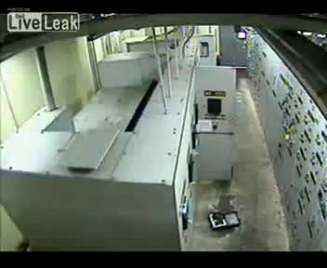
Arc Flash – Case Study

Slide 14

Arc Flash – Case Study

Slide 15
Arc Flash - Defined
A sustained short circuit through air.
Temperature at point of arc: 20,000 ºC
When superheated, air turns to plasma and becomes electrically conductive

Slide 16
Chapter 3.3: The Risk Management System and Elements
Risk Management System (APEGA Model):
Management Leadership, Commitment and Accountability.
Risk Assessment and Management of Risks.
Community Awareness and Emergency Preparedness.
Management of Change.
Incident Reporting, Investigation, Analysis and Actions.
Program Evaluation and Continuous Improvement.
Design, Construction and Start-up.
Operations and Maintenance.
Employee Competency and Training.
Contractor Competency and Integration.
Operations and Facilities Information and Documentation.

Slide 17
Chapter 3.3: The Risk Management System and Elements
Risk Management System (APEGA Model):
Management Leadership, Commitment and Accountability.
Risk Assessment and Management of Risks.
Community Awareness and Emergency Preparedness.
Management of Change.
Incident Reporting, Investigation, Analysis and Actions.
Program Evaluation and Continuous Improvement.
Design, Construction and Start-up.
Operations and Maintenance.
Employee Competency and Training.
Contractor Competency and Integration.
Operations and Facilities Information and Documentation.

Slide 18
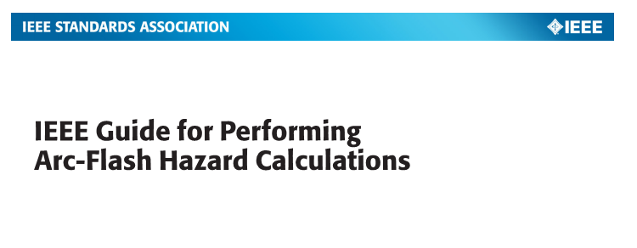
“How dangerous is this electric stuff, and how close should I be to it?”
The incident energy analysis is the quantification of the energy levels present at a given point in the electrical system.
Output from the study:
Incident Energy (cal/cm2)
Arc Flash boundary (cm)

Slide 19
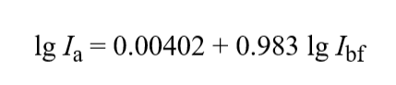
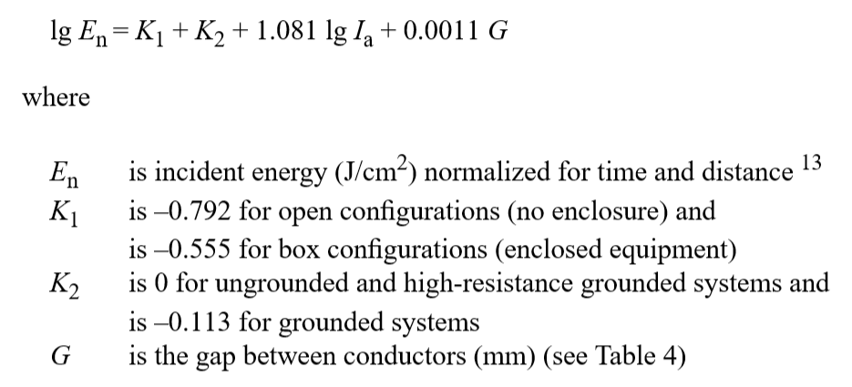
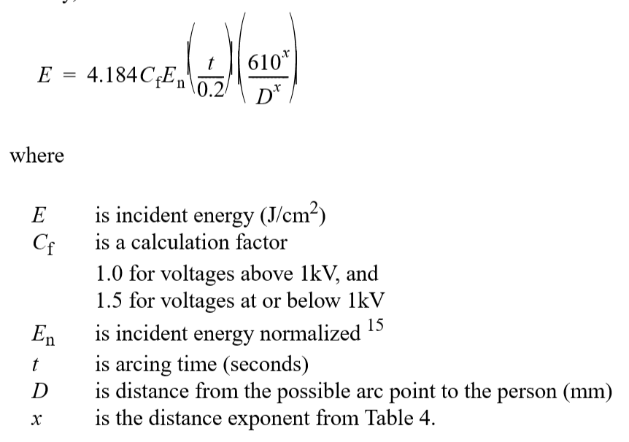
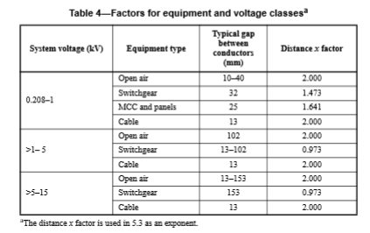
This is not on the exam.
Simplified formula: Incident Energy = Current * Time
Distance²

Slide 20
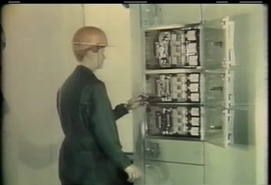

Slide 21
Chapter 3.3: The Risk Management System and Elements
Risk Management System (APEGA Model):
Management Leadership, Commitment and Accountability.
Risk Assessment and Management of Risks.
Community Awareness and Emergency Preparedness.
Management of Change.
Incident Reporting, Investigation, Analysis and Actions.
Program Evaluation and Continuous Improvement.
Design, Construction and Start-up.
Operations and Maintenance.
Employee Competency and Training.
Contractor Competency and Integration.
Operations and Facilities Information and Documentation.

Slide 22
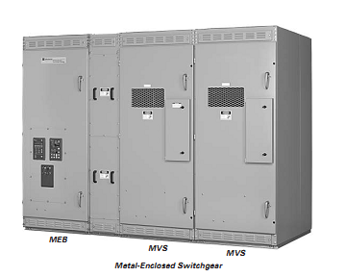
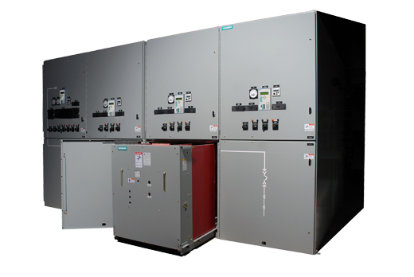
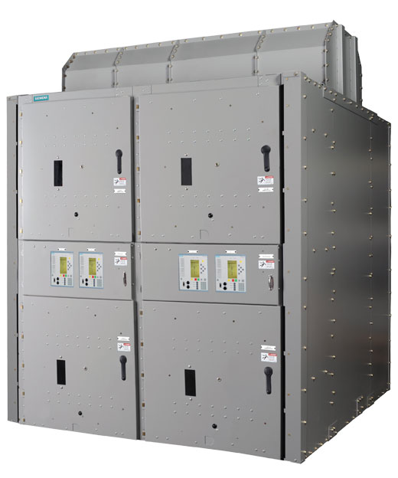
Trade-offs in equipment design/cost
Metal enclosed, metal clad, arc resistant
(This is where a price is put on safety.)

Slide 23
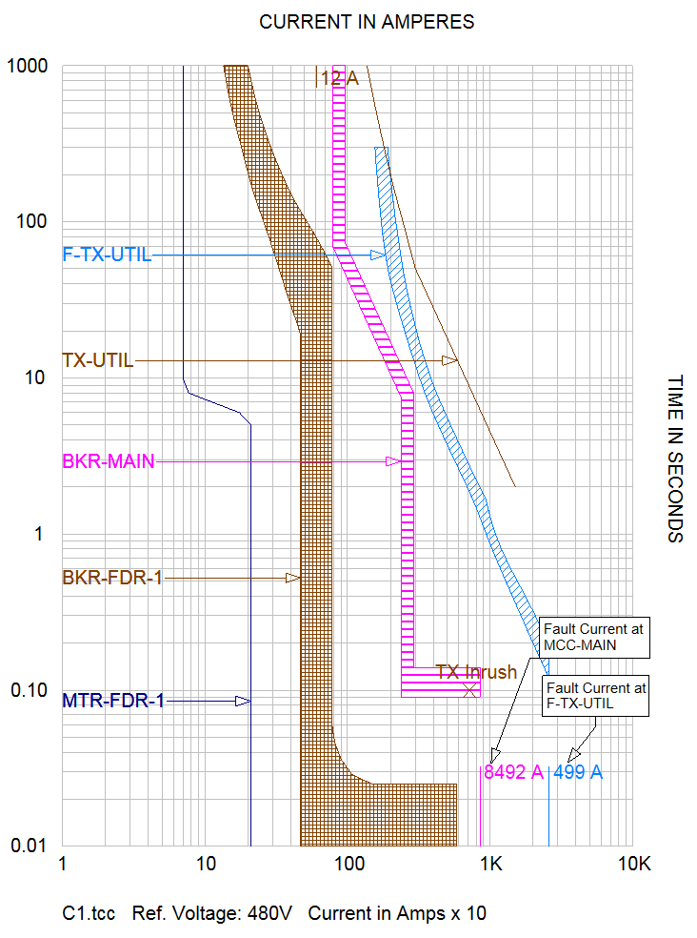
Arc Flash Study
(Incident Energy Analysis)
Engineer to determine settings of devices which protect equipment from electrical faults
Trade-off between speed (safer for people) and reliability (better for production)

Slide 24
Design systems with newer technologies:
High-Speed Arc Detection Relays | faster tripping times
“Maintenance Mode” | faster tripping times
“Chicken Switch” | stand farther away from equipment
Robots for remote racking of breakers | stand farther away from equipment
All of these have additional costs, and the trade-off must be justified by engineering analysis

Slide 25
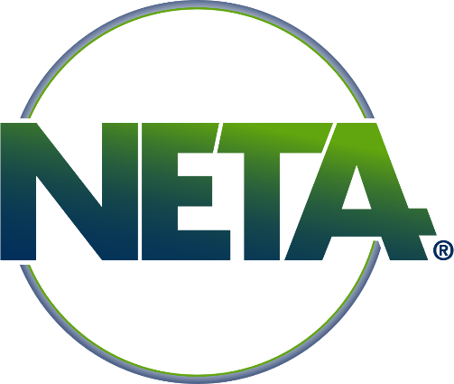
During Construction and Start-Up:
Test all systems to ensure operations according to design
Again, a trade-off with cost. How thorough does your testing need to be?
Inspection & Test Plan versus “Smoke Test”
Industry standards such as InterNational Electrical Testing Association (NETA) can provide guidance.

Slide 26
Chapter 3.3: The Risk Management System and Elements
Risk Management System (APEGA Model):
Management Leadership, Commitment and Accountability.
Risk Assessment and Management of Risks.
Community Awareness and Emergency Preparedness.
Management of Change.
Incident Reporting, Investigation, Analysis and Actions.
Program Evaluation and Continuous Improvement.
Design, Construction and Start-up.
Operations and Maintenance.
Employee Competency and Training.
Contractor Competency and Integration.
Operations and Facilities Information and Documentation.

Slide 27
Facilities Information & Documentation
Could a worker understand the potential hazards?
Could appropriate PPE be selected to mitigate the risk?
Where to find data on both Shock and Arc Flash Hazard?

Slide 28
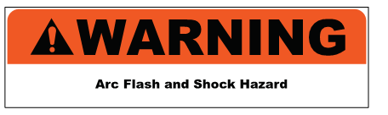
Facilities Information & Documentation
Canadian Electrical Code introduced labeling requirements in 2006
Rule 2-306 (1), “Electrical equipment… shall be field marked to warn persons of potential electric shock and arc flash hazards.”
Header with the word DANGER, WARNING, CAUTION
Message indicating the nature of the potential hazard
Placed in a readily visible location
Not all warning labels are created equal!
CSA Z462-18 Appendix Q Figure Q.1

Slide 29
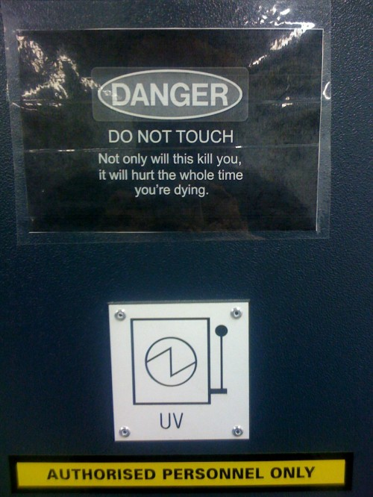
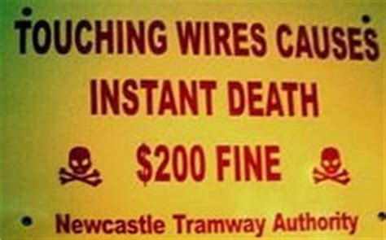
Does this meet Canadian Electrical Code Requirements?

Slide 30
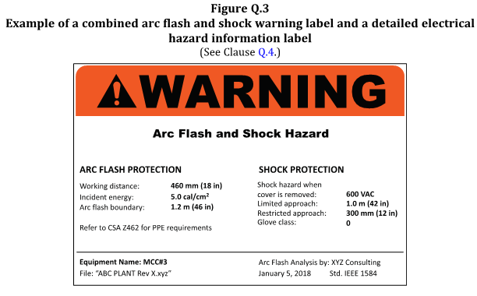
Facilities Information & Documentation
Sample of a detailed warning label:

Slide 31
Chapter 3.3: The Risk Management System and Elements
Risk Management System (APEGA Model):
Management Leadership, Commitment and Accountability.
Risk Assessment and Management of Risks.
Community Awareness and Emergency Preparedness.
Management of Change.
Incident Reporting, Investigation, Analysis and Actions.
Program Evaluation and Continuous Improvement.
Design, Construction and Start-up.
Operations and Maintenance.
Employee Competency and Training.
Contractor Competency and Integration.
Operations and Facilities Information and Documentation.

Slide 32
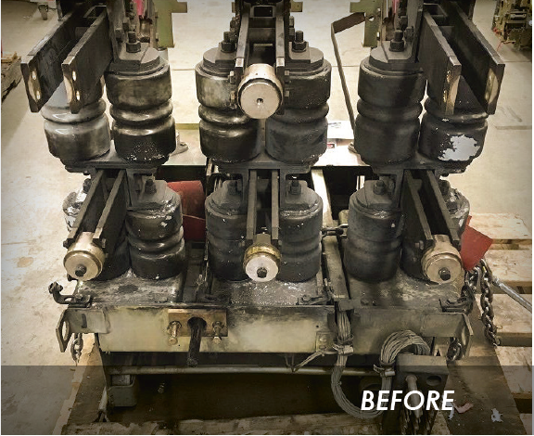
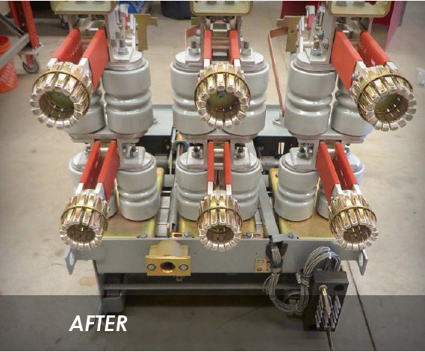
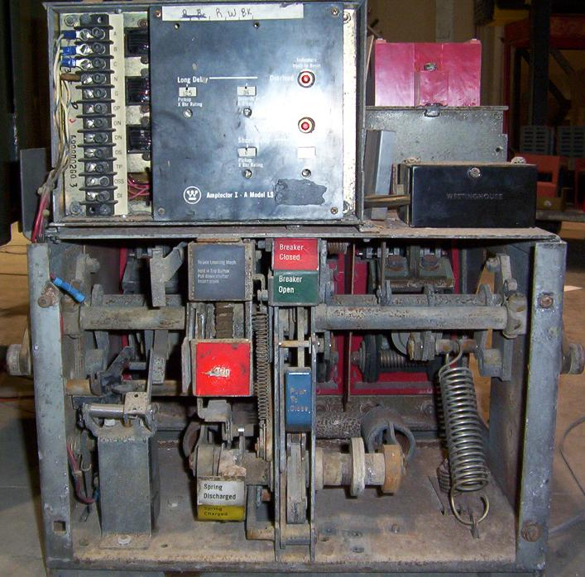
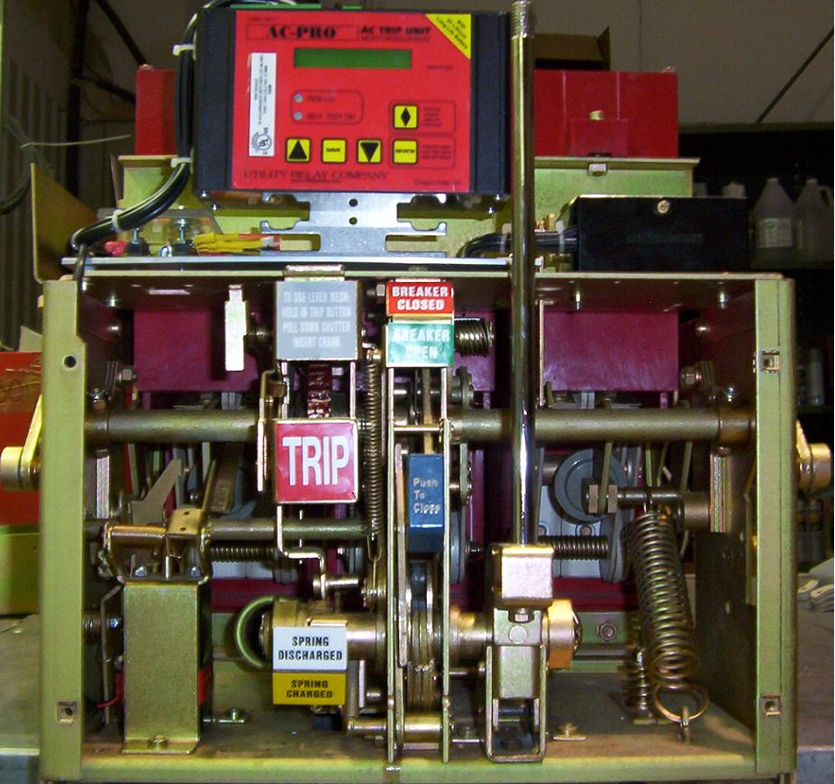
Maintenance
The information contained on the warning labels may not be accurate if proper maintenance is not performed
Power system maintenance is critical to the safe operation of all systems
Electrical power systems equipment operated when it’s in poor condition because of lack of maintenance presents a higher risk of personnel exposure to electrical shock and arcing faults
A NETA study done in October 2007, indicated that 22% of service-aged circuit breakers had some type of malfunction and 10.5% did not operate at all during maintenance testing.
Heid K & Widdup R, Total Clearing Time of Protective Devices and Its Effect of Electrical Hazards

Slide 33
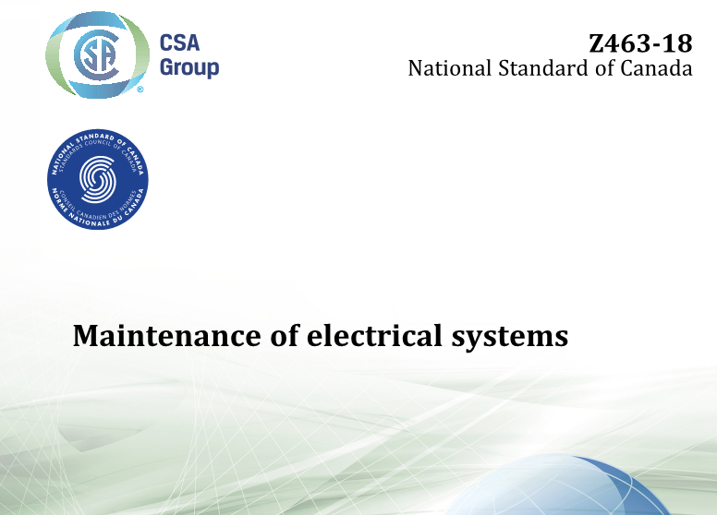
Maintenance
Under normal operating conditions, enclosed energized electrical equipment that has been properly installed and properly maintained is not likely to pose an arc flash risk
Sites shall have procedures and practices in place to manage the integrity of electrical equipment
CSA Z462 recommends referring to CSA Z463 for guidance related to electrical maintenance strategies

Slide 34
Chapter 3.3: The Risk Management System and Elements
Risk Management System (APEGA Model):
Management Leadership, Commitment and Accountability.
Risk Assessment and Management of Risks.
Community Awareness and Emergency Preparedness.
Management of Change.
Incident Reporting, Investigation, Analysis and Actions.
Program Evaluation and Continuous Improvement.
Design, Construction and Start-up.
Operations and Maintenance.
Employee Competency and Training.
Contractor Competency and Integration.
Operations and Facilities Information and Documentation.

Slide 35
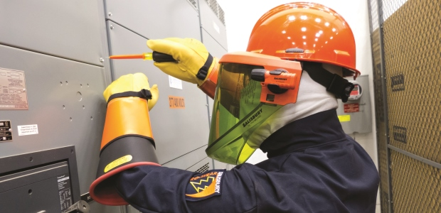
Personal Protective Equipment -Alberta OH&S
Code Part 18, 232 (1):
“If a worker may be exposed to a flash fire or electrical equipment flashover, an employer must ensure that the worker wears flame resistant outerwear and uses other protective equipment appropriate to the hazard.”
Photo: www.ohsonline.com

Slide 36
Personal Protective Equipment
Specialized PPE relating to electrical hazards:
Insulating Gloves
Arc Resistant clothing
Hood / Face Shield
Voltage rated “hot-stick”
Voltage tester
Safe work grounds

Slide 37
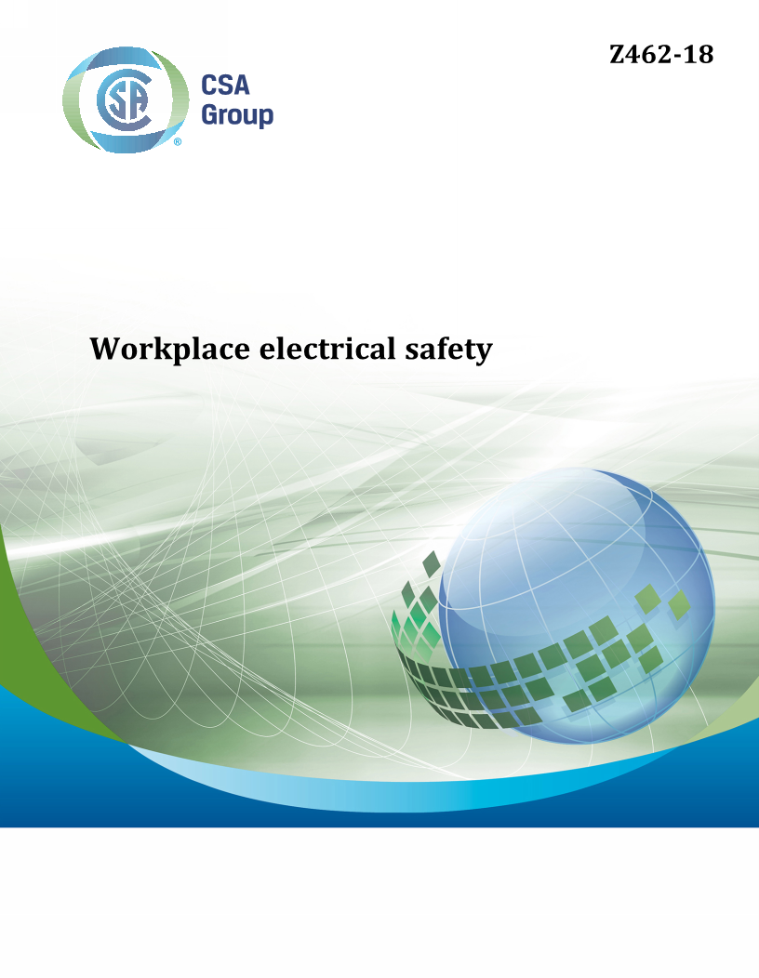
Personal Protective Equipment -CSA Z462
Workers exposed to electrical hazards when the risk associated with that hazard is not adequately reduced by the applicable electrical installation requirements shall be provided with and use protective equipment that is designed and constructed for the specific part of the body to be protected and for the work to be performed

Slide 38
Chapter 3.3: The Risk Management System and Elements
Risk Management System (APEGA Model):
Management Leadership, Commitment and Accountability.
Risk Assessment and Management of Risks.
Community Awareness and Emergency Preparedness.
Management of Change.
Incident Reporting, Investigation, Analysis and Actions.
Program Evaluation and Continuous Improvement.
Design, Construction and Start-up.
Operations and Maintenance.
Employee Competency and Training.
Contractor Competency and Integration.
Operations and Facilities Information and Documentation.

Slide 39
Management Commitment
To operating and maintaining a safe and reliable electrical system, with
Adequate training for both qualified electrical and non-qualified staff, with
Access to industry’s best practices for safe work procedures and personal protective equipment, and
Due consideration for upgrading to latest technologies for safe equipment design.

Slide 41
ENGG404 - LECTURE
Fundamentals of RM
RM System and Process
Leadership in RM
Incident Investigation
RM Tools & Challenges
RM in Industry
People & Org.
Application and Perspectives
Safety and Risk Management in the Electrical Engineering Industry

